Slide 1

parallel project
Names of the members:
1-Fares Shawli | 2142645.
2-Saleh Almotairi | 2041130.
3-Ibrahim Alessa | 2040547.
4-Ahmed Al-shmrani | 2141663.
5-Abdulrahman Maghrabi | 2042791.

Slide 2



INTRODUCTION
The algorithm can be used to find the prime numbers in a set of natural numbers {2,3 ... ... ... , 𝑁}. Since the number ‘2’ is the first prime number, the algorithm starts with this number and eliminates all other number that are multiples of 2. The number is then incremented, and the process is repeated until the number 𝑝 > √𝑁. The maximum prime number found is printed at the end.

Slide 3
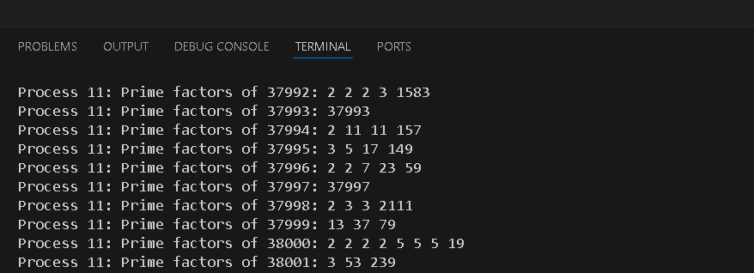
IMPLEMENTATION
We did implementation using C code on the examples given in the word file of the project and here’s the the output:

Slide 4
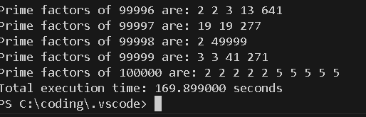
Sequential IMPLEMENTATION
You can notice when the user enter a larger number the execution time will take a longer every time like the output showing below:

Slide 5
OpenMP and MPI version
OpenMP version
MPI version
utilizes MPI (Message Passing Interface) to parallelize the task of prime factorization. In this MPI version, the prime factorization task is divided among multiple processes, allowing for concurrent computation on distributed systems.
Each process in the MPI communicator calculates the prime factors for a subset of numbers within a given range. The range of numbers to factorize is evenly divided among the processes based on their rank.
The MPI processes independently execute the prime_factors() function to find the prime factors for the assigned subset of numbers. After completing the computation, each process prints the prime factors it has found along with its rank.
Timing measurements are taken to determine the execution time of the parallel section on each process, as well as the total execution time across all processes. These measurements provide insights into the performance of the parallel implementation.
After completing the computation and timing measurements, MPI barrier synchronization is used to ensure that all processes have finished their tasks before proceeding to calculate the total execution time.
Overall, this MPI version of prime factorization leverages parallel computing to efficiently distribute the workload across multiple processes, potentially reducing the overall execution time compared to a sequential implementation.
The provided C code utilizes OpenMP, a shared-memory parallelization API, to parallelize the task of prime factorization.
Each thread in the OpenMP framework independently calculates prime factors for a subset of numbers within a given range. The range of numbers to factorize is evenly divided among the threads.
The prime factorization is performed within a parallel section defined by `#pragma omp parallel for`. Each thread executes the `primeFactorization` function for numbers from 2 to `N`. Inside this function, each thread prints its ID along with the prime factors it finds for the given number.
Timing measurements are taken to determine the execution time of the parallel section. This provides insights into the performance of the parallel implementation.
Overall, this OpenMP version of prime factorization utilizes shared-memory parallelism to potentially speed up the computation compared to a sequential approach.

Slide 6
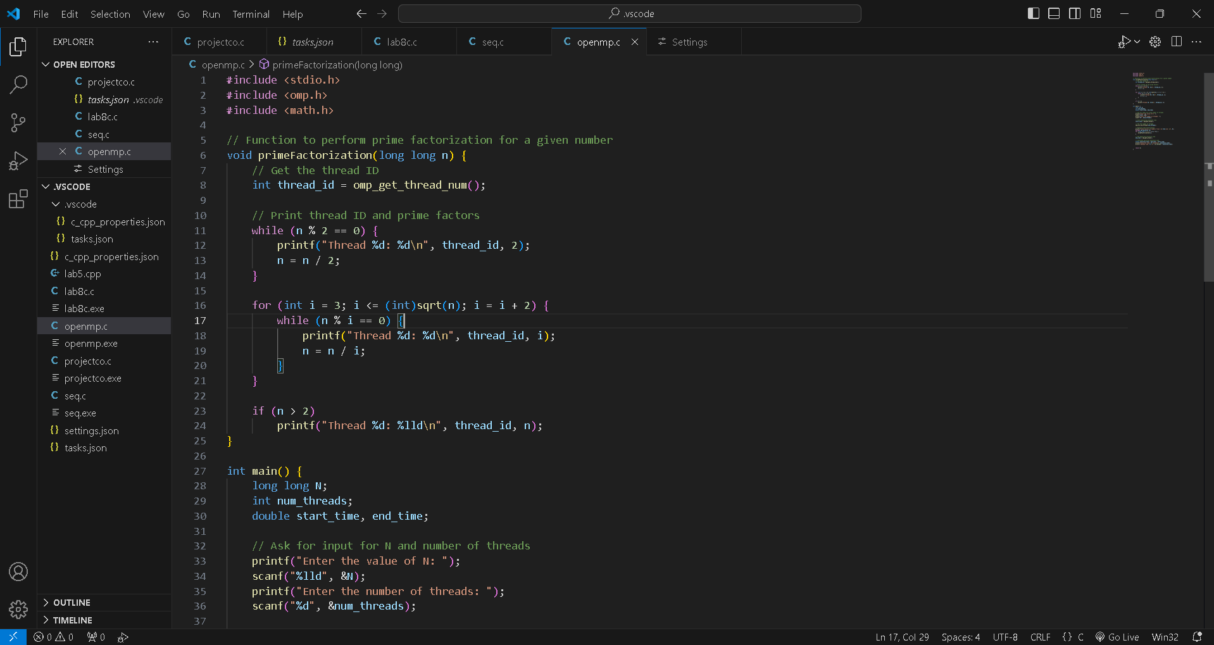
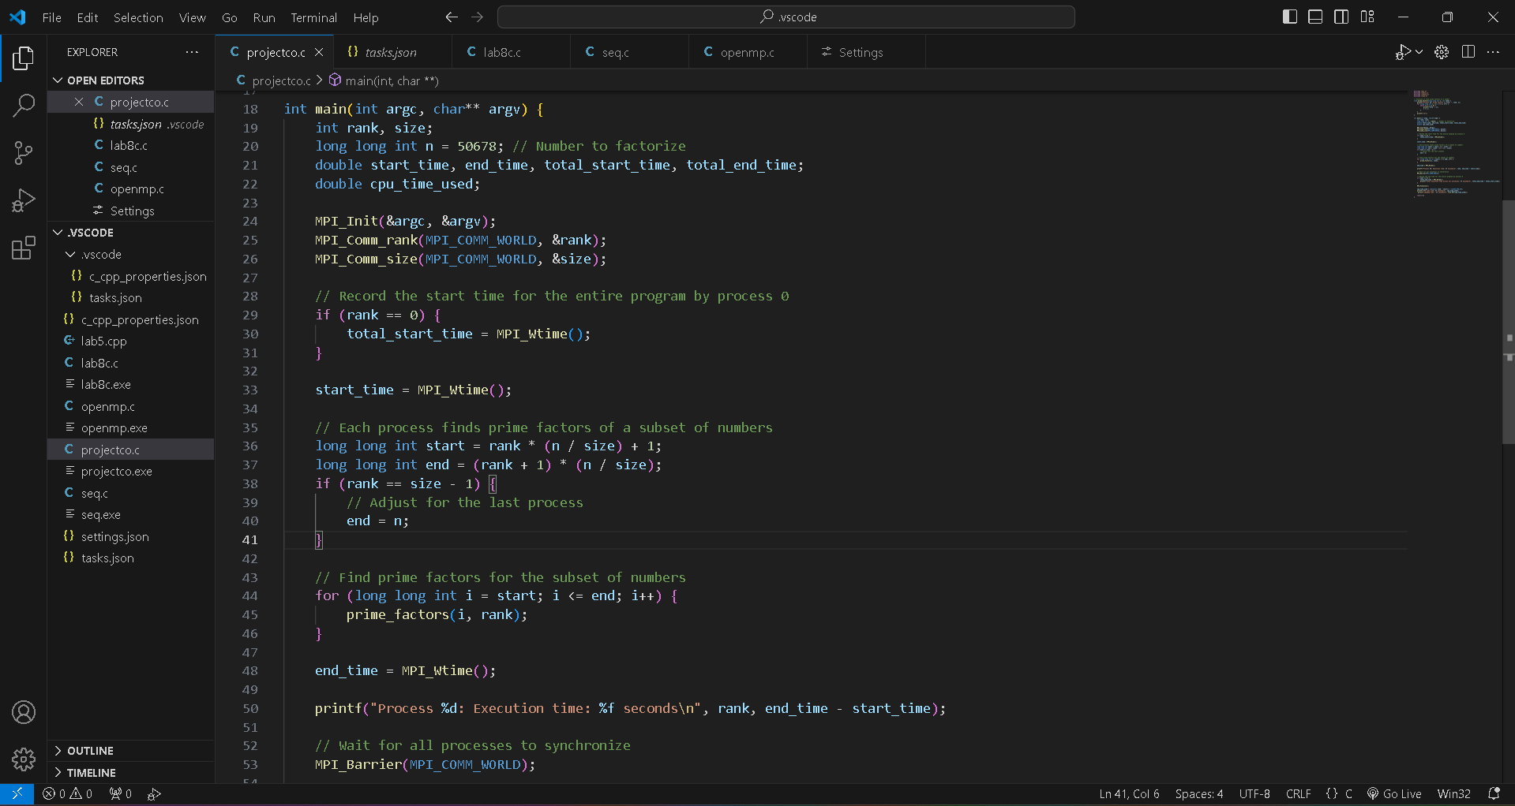
CODING
OpenMP Version
MPI Version

Slide 7
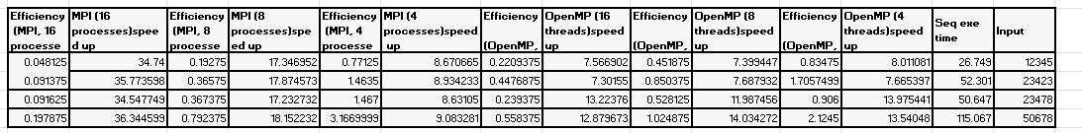
OBSERVATION AND ANALYSIS
The results indicate that both MPI and OpenMP versions perform significantly better than the sequential version. It can be seen from the data below that the parallelized implementations give a much smaller time of execution.

Slide 8
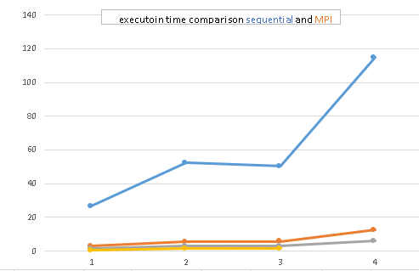
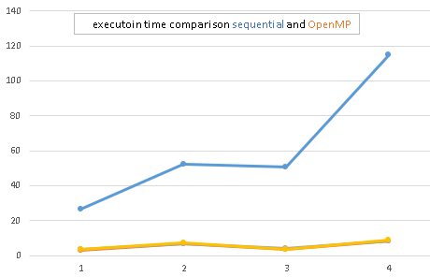
OBSERVATION AND ANALYSIS

Slide 9
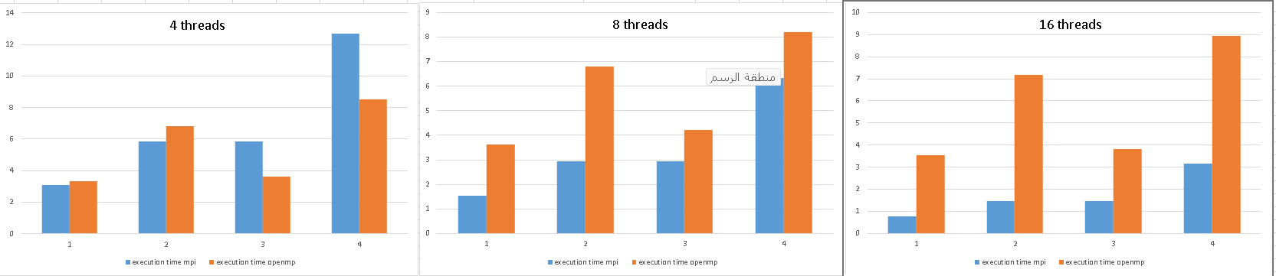
OBSERVATION AND ANALYSIS

Slide 10
AMDAHL’S LAW:
speedup=ts/tp
efficiency= speedup/num of pro *1
We used these laws to count for the speedup and efficiency

Slide 11
CONCLUSION
The best version is MPI based on speed up and execution time but OpenMP is more efficient
Thank you

